Slide 1
Dynamic Movie
Recommendation System
Team 1
Yang Bai, 1063031
Xuejiao Dong, 1569734
Giang Vu, 1537937
Linxiu Jiang, 1051136

Slide 2
Introduce Recomendation System
Dataflow-simulator
ETL
Machine Learning
User Interface
Data Visualization

Slide 3
Goals of Project
learn how to implement a dynamic Big Data ecosystem
apply our Scala knowledge learned in class to Spark to solve a common, real-world problem
Improve the user experience by improving the accuracy of the recommendation system

Slide 4
Use Cases (Business Use Cases)
User logins to system, and login service verifies user ID and password
If user is a new user, Recommendation System recommends top 10 popular movies
If use is an old user, Recommendation System recommends what this user likes
Real user rates movie by giving 0-5 star and gets recommendations in real-time
A new user becomes an old user by rating any movie
User types in other user ID, and gets intersection between what he/she likes and what others like
User views movie list by genres

Slide 5
Use Cases (System Use Cases)
Data Flow Service simulates data flows
Data ETL Service collects all the rating records, and extract, transform, load these data
ML Service keeps training and building a new model based on the historical model and new dataset
ML model recommends 10 potential favorite movies to users
Virtualization Service virtualize data flows and accuracy of model

Slide 6
Data Source
https://files.grouplens.org/datasets/movielens/ml-25m-README.html
This dataset describes 5-star rating. It contains 25,000,095 ratings and 1,093,360 tag applications across 62,423 movies. These data were created by 162,541 users between January 09, 1995 and November 21, 2019.
ratings.csv: userId,movieId,rating,timestamp
tags.csv: userId,movieId,tag,timestamp
movies.csv: movieId,title,genres
links.csv: movieId,imdbId,tmdbId
genome-scores.csv and genome-tags.csv: movieId,tagId,relevance

Slide 7
Milestones/sprints
Week 9 (Nov. 1st - 7th) - Prepare Dev Environment, Learn New Techniques (All)
Week 10 (Nov. 8th - 14th) - Simulate DataFlow + Visualization (Linxiu)
Week 11 (Nov. 15th - 21st) - ETL DataSet + Visualization (Xuejiao)
Week 12 (Nov. 22nd - 28th) - ML Train and Build Model + Visualization (Yang)
Week 13 (Nov. 29th - Dec.5th) - UI + Visualization (Glenn)
Week 14 (Dec.6th - Dec.8th) - Final testing/Presentation (All)

Slide 8
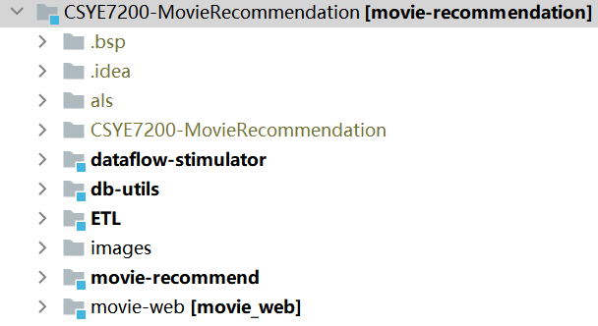
Project & Modules

Slide 9
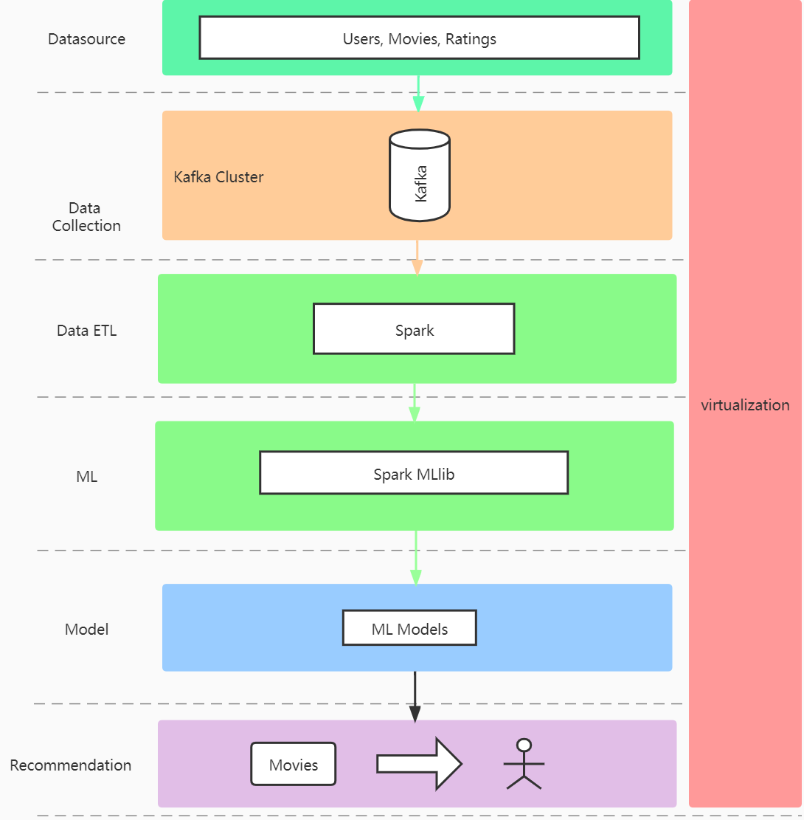
Architecture

Slide 10
System Pros
high code performance & efficient development (scala)
pressure endurance for big scale data (Kafka)
accurate recommendation (Algorithm Optimization)
quick recommendation (Redis Cache)
abundant way of interaction (UI, data virtualization)

Slide 11
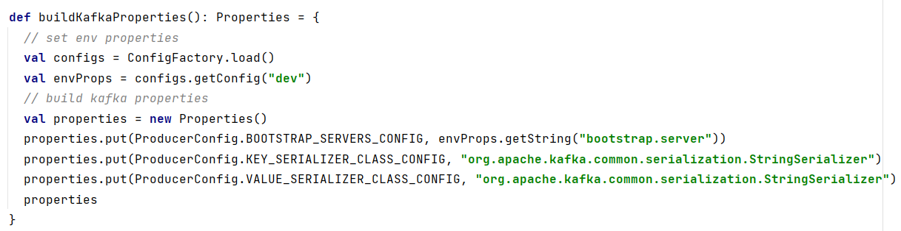
Dataflow Simulator (1)
buildKafkaProperties()

Slide 12
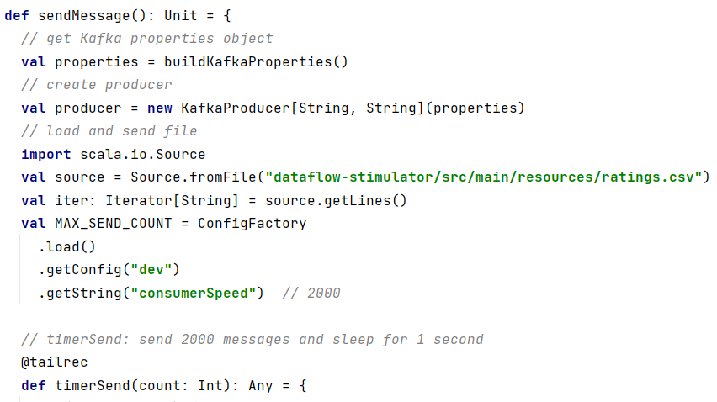
Dataflow Simulator (2)
sendMessage

Slide 13
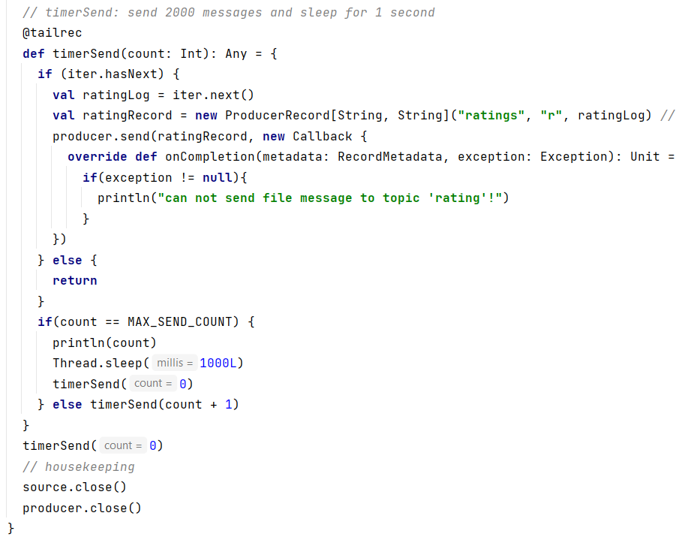
Dataflow Simulator (3)
timerSend

Slide 14
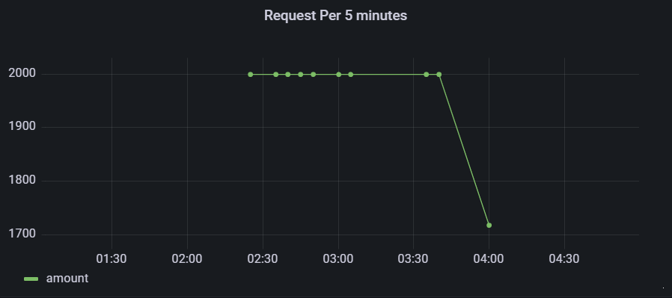
Dataflow Simulator (4)

Slide 15
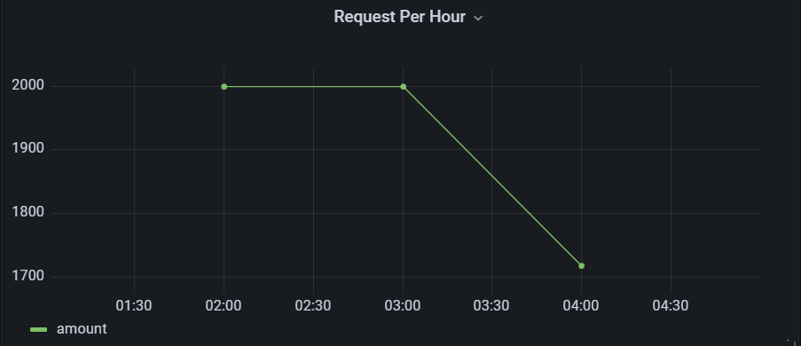
Dataflow Simulator (5)

Slide 16
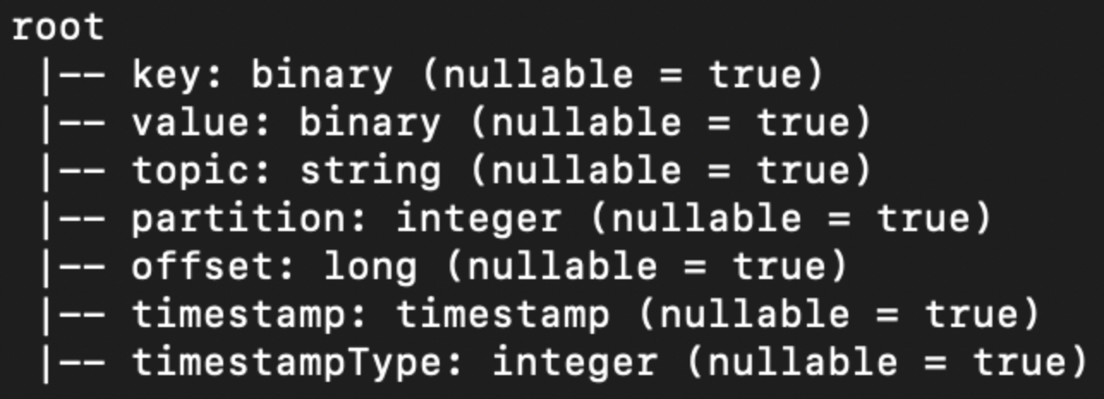
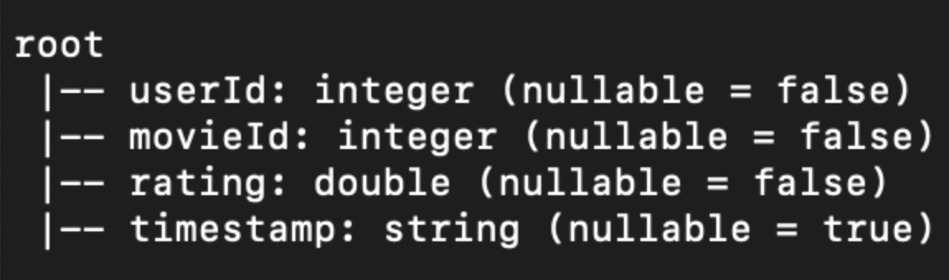
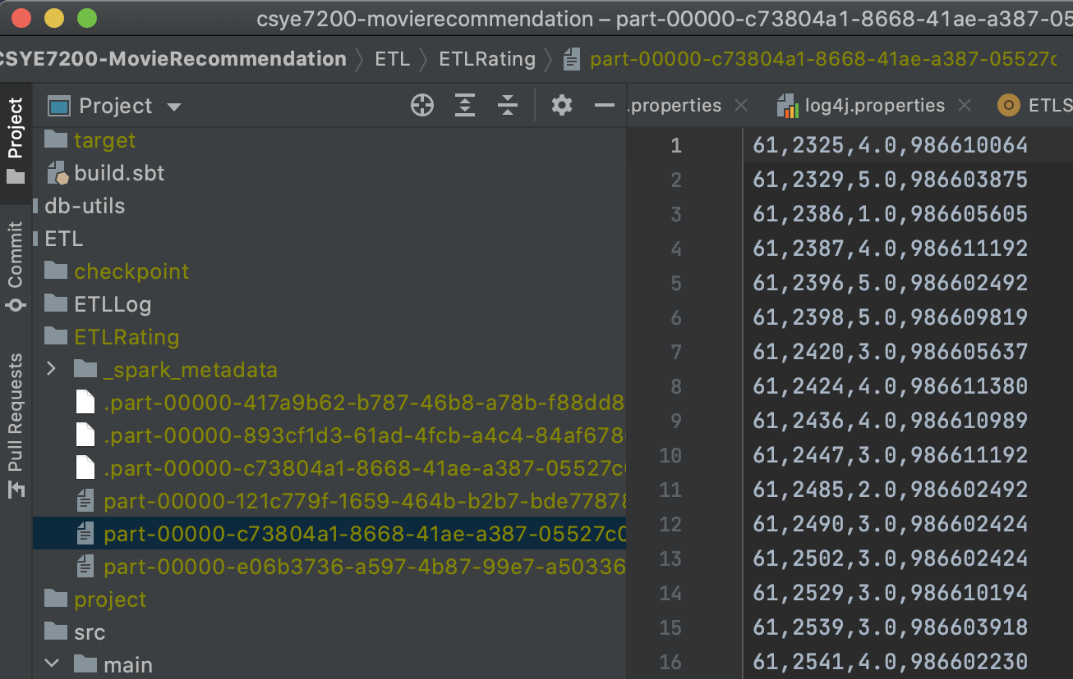
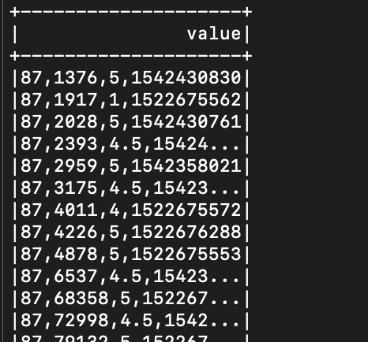
ETL(1)
The transformation of Data in ETL Model
Raw Data From
Kafka
Datast[RatingLog]
CSV
logging cleaned data sample in console

Slide 17
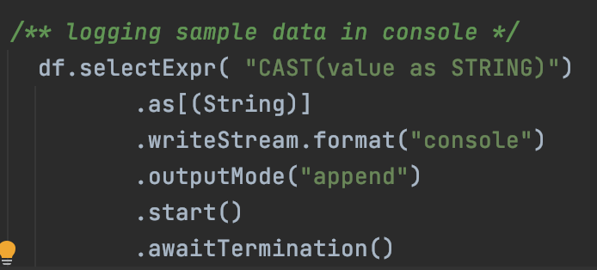
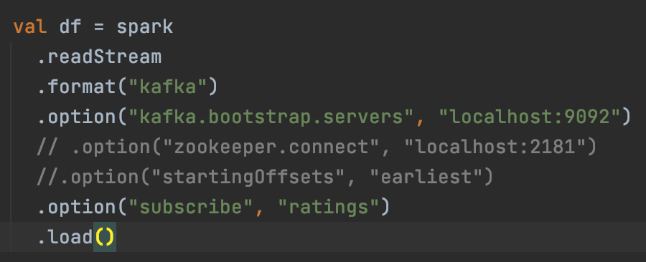
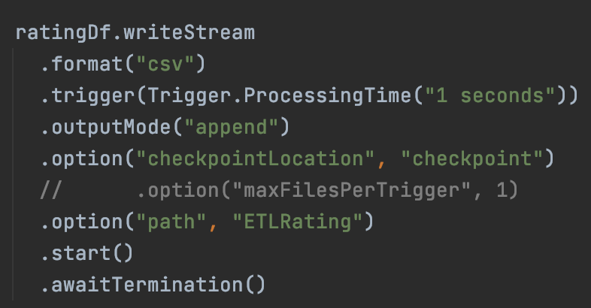
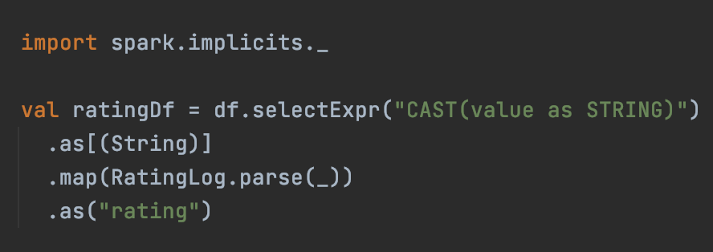
ETL(2)
Code Implementation

Slide 18
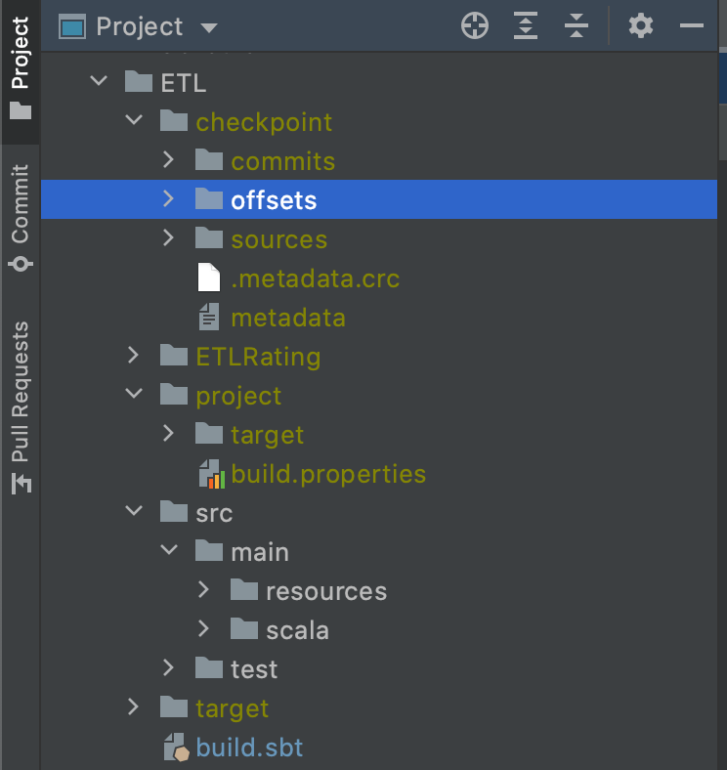
ETL(3)
Checkpoint helps build fault-tolerant and resilient Spark applications. In Spark Structured Streaming, it maintains intermediate state on HDFS compatible file systems to recover from failures.
Checkpoint

Slide 19
Machine Learning
Define problem
Find solutions/models
Evaluate them
Virtualize them

Slide 20
Machine Learning - Define problem
Predict movie rating
Recommend the movies with highest rating to user

Slide 21
Machine Learning - solutions/models
Traditionally, KNN, SVM
Sparse Matrix
Latency Factor between users and movies
Matrix factorization
Loss Function = Mean Square Root of Error
ALS, Gradient Descent
CV, Grid Search
Save recommendations to Redis (speedup)

Slide 22
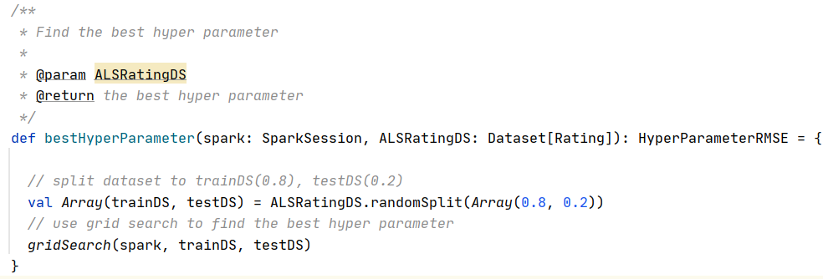
Machine Learning - solutions/models

Slide 23
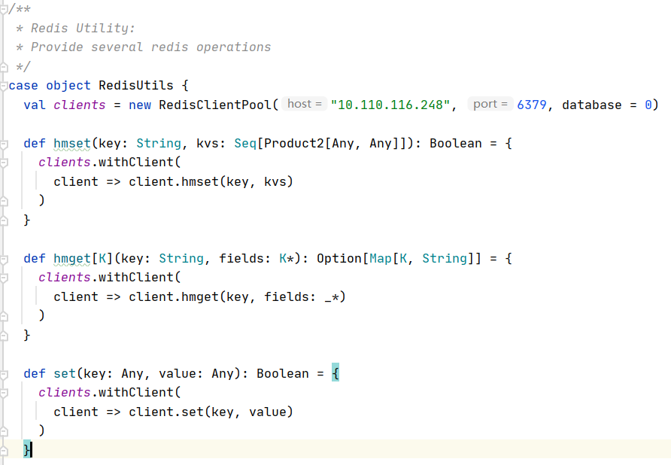
Machine Learning - solutions/models

Slide 24
Machine Learning - Evaluatation
RMSE (Root Mean Square Error)
Accuracy = 1 - RMSE/5
If RMSE is 0, that means there is no loss/error, so accurracy is 1 (or 100%); If RMSE is 5 which is highest rating user can give to a movie, there will be high loss/error, so accuracy is 0 (or 0%);

Slide 25
Machine Learning - Cold Start Problem
Problem: new user with less ratings
Solution: statistic recommendation
Detail: top N movies, top N movies per genre
Reason: user taste change, give user more interest to explore

Slide 26
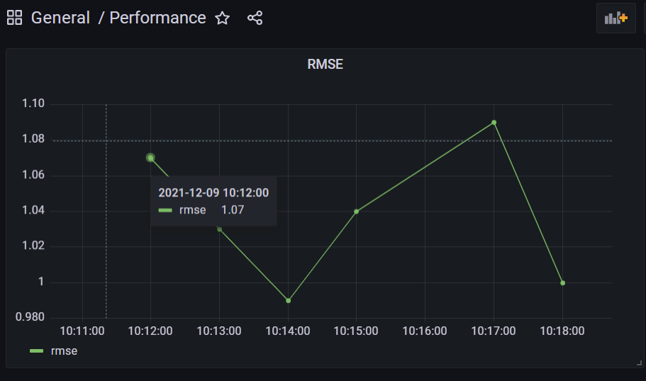
Machine Learning - Virtualization

Slide 27
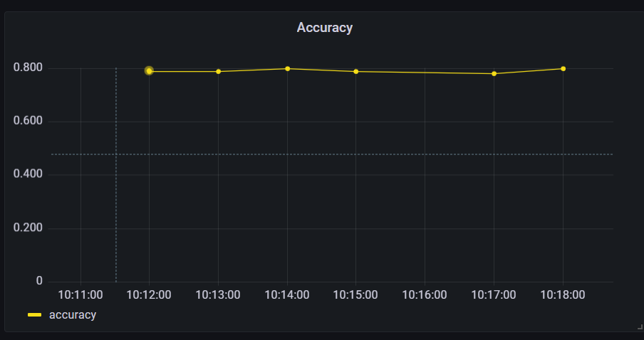
Machine Learning - Virtualization

Slide 28
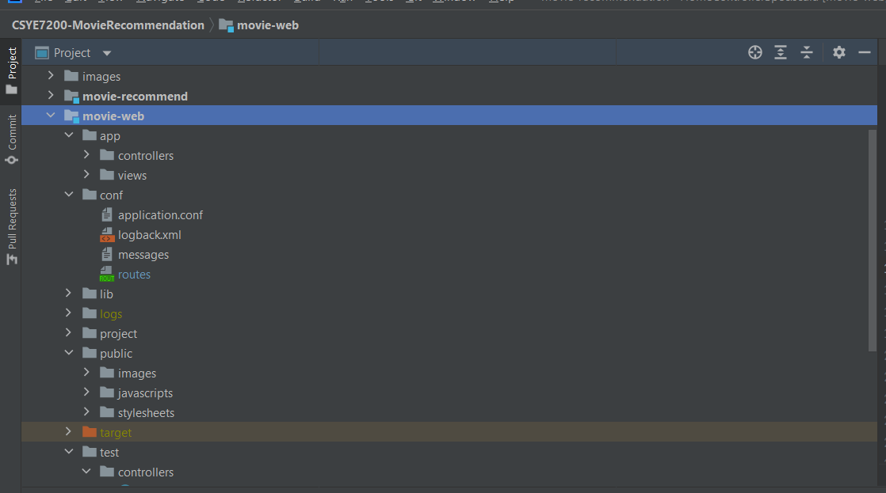
User Interface
Play Framework 2.8
Scala code for class/controller
HTML + CSS for basic page UI

Slide 29
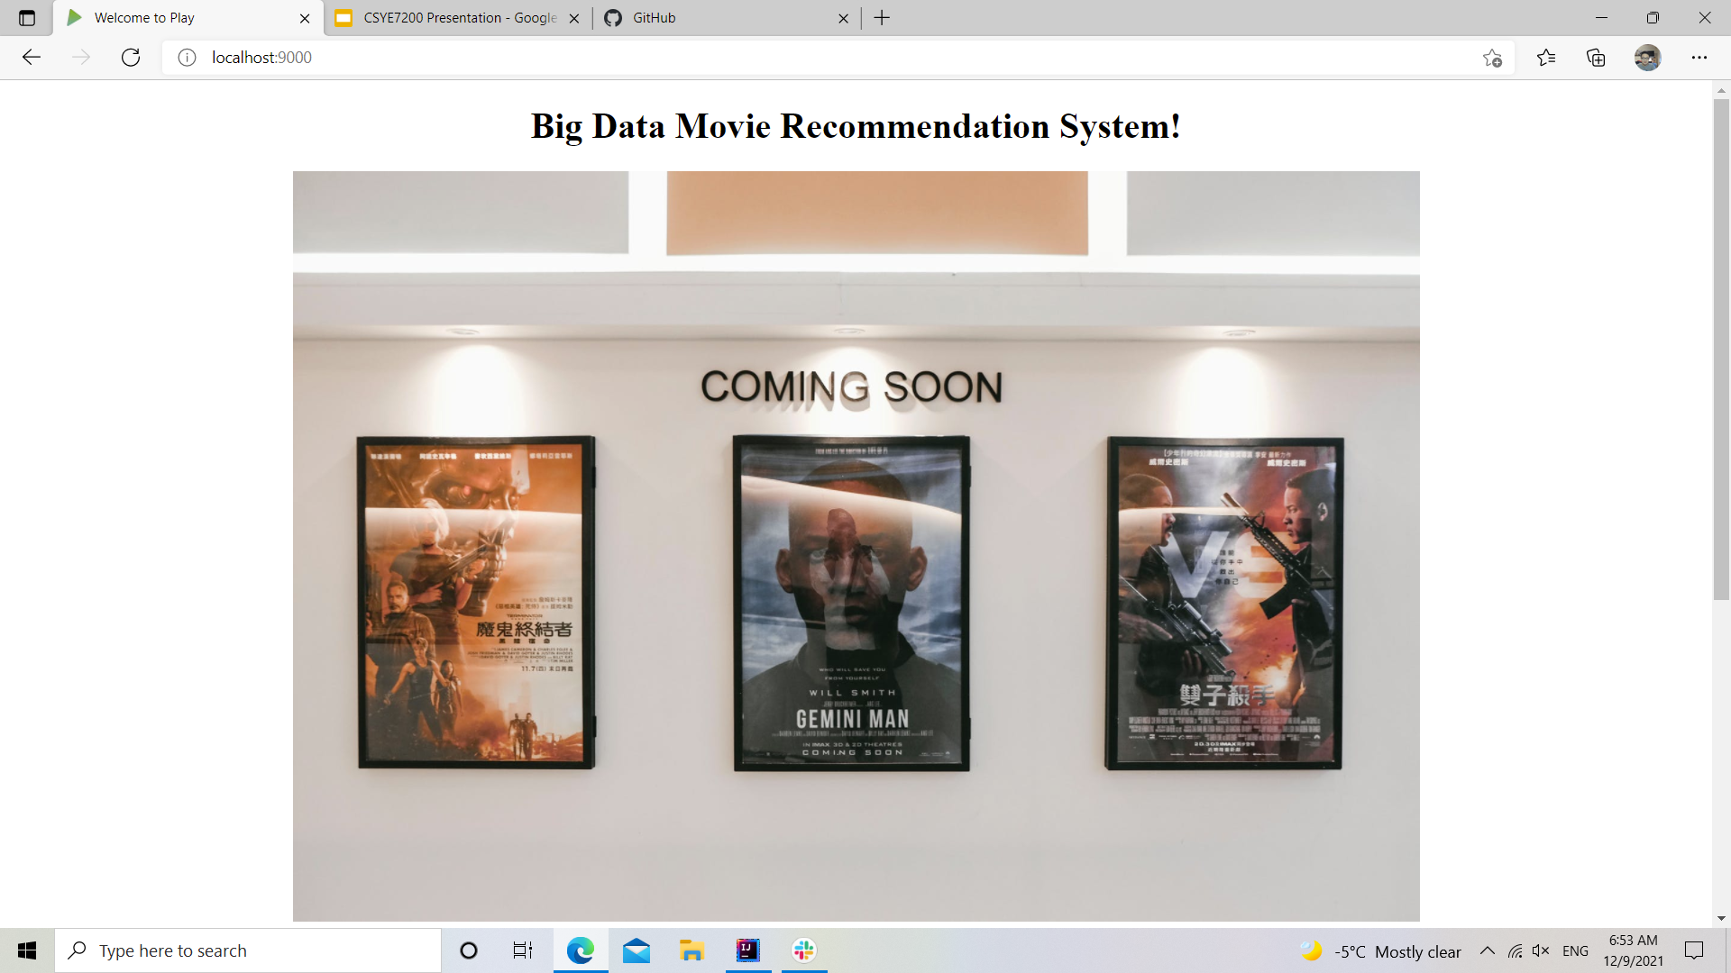
User Interface

Slide 30
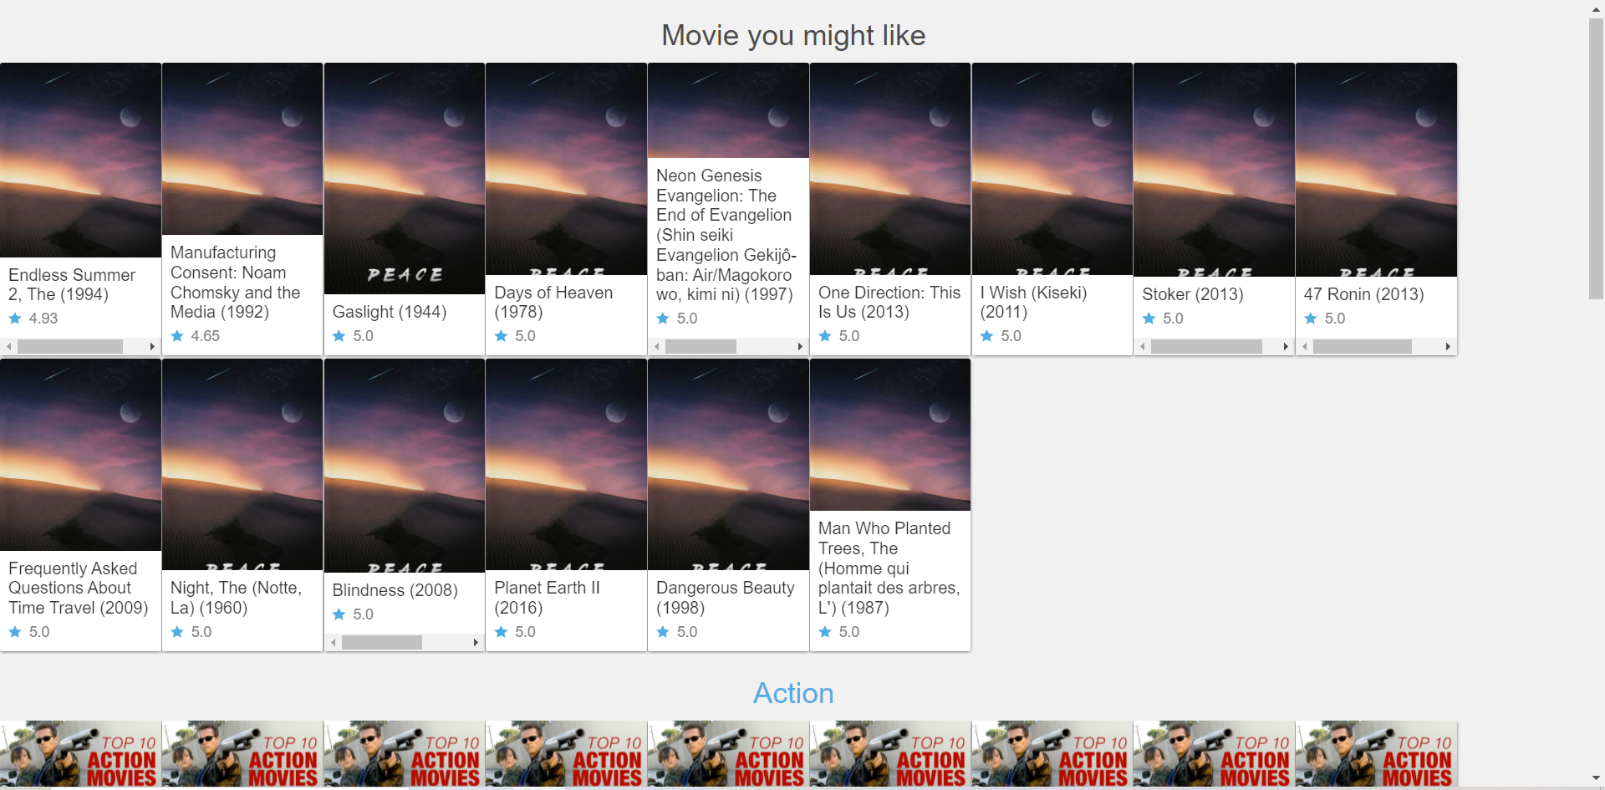
User Interface (cont)

Slide 31
Acceptance Criteria
Stimulate DataFlow
stimulate real-time user rating requests, 1000 requests per seconds (Done)
ETL DataSet
present cleaned data samples in each steps by logging (Done)
ML Train and Build Model
expected accuracy threshold greater than 75% (Done)
Visualization
the amount of requests (users’ rating) by mins, hours (1s) (Done)
accuracy tendency chart (1s) (Done)
real user rates movie and gets recommendations less than 2 seconds (Done)

Slide 32
Q & A

